Slide 1
Introduction to the Internet and Web Design
Chapter 1

Slide 2
Objectives
You will have mastered the material in this chapter when you can:
Define the Internet and associated key terms
Recognize Internet protocols
Discuss web browsers and identify their main features
Describe the types and purposes of websites
Plan a website for a target audience
Define a wireframe and a site map
Explain how websites use graphics, navigation tools, typography, and color

Slide 3
Objectives (continued)
Design for accessibility
Design for multiplatform display
Define Hypertext Markup Language (HTML) and HTML elements
Recognize HTML versions and web programming languages
Identify web authoring tools
Download and use a web authoring tool
Create and view a basic HTML webpage

Slide 4
Introduction
Millions of people worldwide have access to the Internet
World’s largest network; billions of webpages
Used to search for information, communicate with others around the world, and seek entertainment
HTML 5.2 is the most recent version of HTML and is called HTML 5

Slide 5
Project — Create a Basic Webpage
This chapter reviews how to create a webpage
The roadmap identifies general activities
RUN a TEXT EDITOR and CREATE a BLANK DOCUMENT
ENTER HTML TAGS in the document
ADD TEXT to the webpage
SAVE the WEBPAGE as an HTML document
VIEW the WEBPAGE in a browser

Slide 6
Exploring the Internet
The Internet is a worldwide collection of computers
Linked together for use by organizations, and individuals using communications devices and media
A node is any device, such as a computer, tablet, or smartphone, connected to a network
A network is a collection of two or more computers linked together to share resources and information
The Internet of Things describes the ever-growing number of devices connecting to a network, including televisions and appliances

Slide 7
Exploring the Internet (continued)
Data lines that connect networks allow data to move from one computer to another
The Internet backbone is a collection of high-speed data lines that connect major computer systems located around the world
An Internet Service Provider (ISP) is a company that has a permanent connection to the Internet backbone

Slide 8
World Wide Web
The World Wide Web, also called the web, is the service that provides access to information stored on web servers
The web consists of a collection of linked files known as webpages
A website is a related collection of webpages created and maintained by a person, company, educational institution, or other organization

Slide 9
World Wide Web (continued 1)
A home page is the first document users see when they access a website
A hyperlink, commonly called a link, is an element that connects one webpage to another webpage on the same server or to any other web server in the world

Slide 10
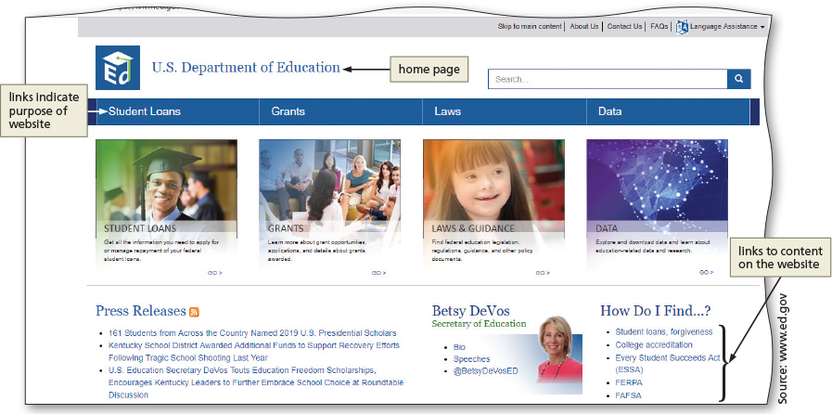
World Wide Web (continued 2)
Figure 1–3

Slide 11
Protocols
Set of rules that define how a client workstation can communicate with a server
A server is the host computer that stores resources and files for websites
Hypertext Transfer Protocol (HTTP) is a set of rules for exchanging text, graphics, audio, video, and other multimedia files on the web
File Transfer Protocol (FTP) is used to exchange files from one computer to another over the Internet
Does not provide a way to view a webpage

Slide 12
Protocols (continued)
Transmission Control Protocol/Internet Protocol (TCP/IP) is a pair of protocols
Used to transfer data efficiently over the Internet by properly routing it to its destination
Internet Protocol (IP) ensures data is sent to the correct location
The Domain Name System (DNS) associates an IP address with a domain name

Slide 13
Web Browsers
Interpret and display webpages and enable you to view and interact with a webpage
Microsoft Edge, Mozilla Firefox, Google Chrome, Apple Safari, and Opera
A Uniform Resource Locator (URL) is the address of a document or other file accessible on the Internet
Such as www.w3.org.com
A domain is an area of the Internet a particular organization or person manages

Slide 14
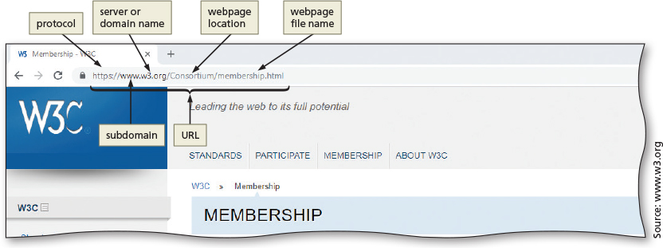
Web Browsers (continued)
Figure 1–8

Slide 15
Types of Websites
An Internet site is another term for a website that is generally available to anyone with an Internet connection
An intranet is a private network that uses Internet technologies to share company information among employees
An extranet is a private network that uses Internet technologies to share business information with select corporate partners or key customers

Slide 16
Types of Websites (continued)
Many company websites also support electronic commerce (e-commerce)
The buying and selling of goods and services on the Internet
Educational institutions use a Learning Management System (LMS) to simplify course management
An LMS is a web-based software application designed to facilitate online learning

Slide 17
Planning a Website
Purpose of the website
The purpose of a commercial business website is related to the goal of selling products or services
Target audience
The people who use the website
Knowing their general demographic background will help to design a website appropriate for them
Multiplatform display
A responsive design of a website must be created that provides an optimal viewing experience across a range of devices

Slide 18
Wireframe
A simple, visual guide that clearly identifies the location of main webpage elements
Active white space is an area on the page that is intentionally left blank
Passive white space is the space between content areas
Helps a user focus on one part of the page

Slide 19
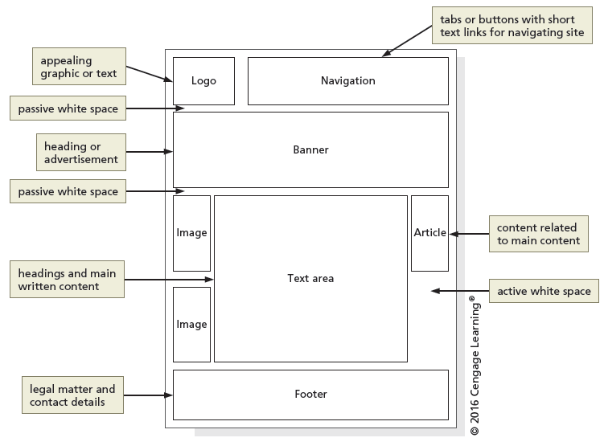
Wireframe (continued)
Figure 1-12

Slide 20
Site Map
A planning tool that lists or displays all the pages on a website
Indicates how they are related to each other
Shows the structure of a website
A linear website structure connects webpages in a straight line
In a variation of a linear website structure, each page can include a link to the home page of the website
A hierarchical website connects webpages in a treelike structure
A webbed website structure has no set organization

Slide 21
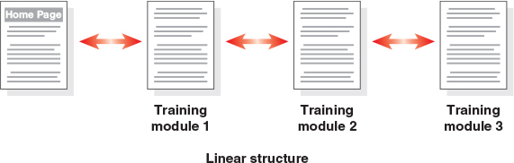
Site Map (continued 1)
Figure 1–13

Slide 22
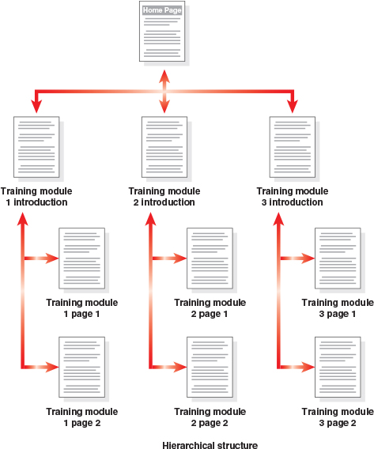
Site Map (continued 2)
Figure 1-15

Slide 23
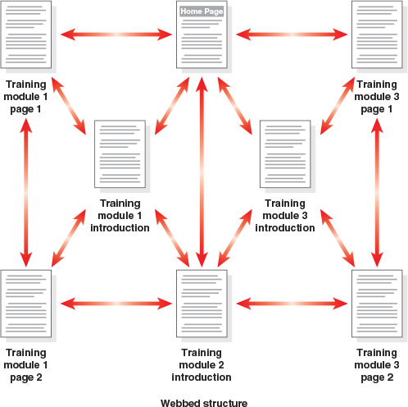
Site Map (continued 3)
Figure 1-16

Slide 24
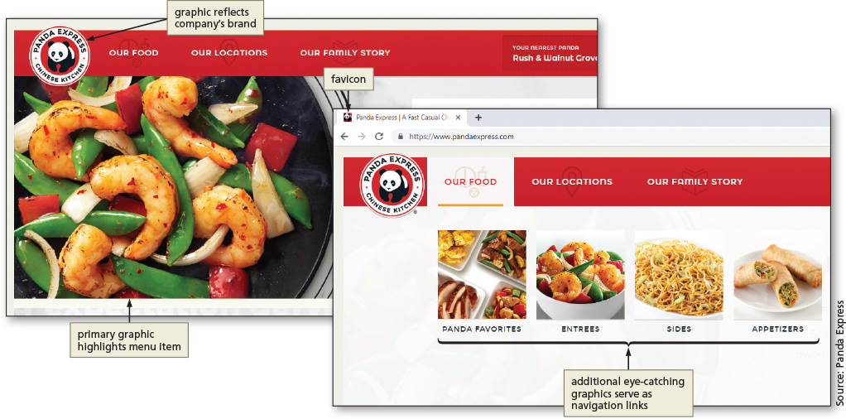
Graphics
Graphics add visual appeal to a webpage and enhance the visitor’s perception of the products and services
Figure 1–17

Slide 25
Navigation
The navigation of a website should be clear and concise
Each webpage should have a designated navigation area with links to other pages in the site
Navigation area should be prominent and easy to use

Slide 26
Typography
The use of effective typography, or fonts and font styles, enhances the visual appeal of a website
Typography also should promote the purpose and goal of the website

Slide 27
Color
The combination of colors contributes to the appeal and legibility of the website
Aim to strike a balance among the background color, text color, and the color that represents a brand
Colors convey meanings

Slide 28
Color (continued)
Color | Common Meaning
Red | Love, romance, anger, energy
Blue | Trust, loyalty, integrity, honesty, dependability
Green | Freshness, friendliness, health, safety, strength
Yellow | Warmth, cheer, joy, excitement, humor
Orange | Energy, warmth, health
Brown | Nature, wholesomeness, simplicity, friendliness
Black | Elegance, tradition, sophistication, formality
White | Purity, honesty, sincerity, cleanliness
Table 1-2: Common Color Meanings

Slide 29
Accessibility
A web designer should create pages for viewing by a diverse audience, including people with physical impairments and global users
The World Wide Web Consortium (W3C) develops and maintains web standards, language specifications, and accessibility recommendations

Slide 30
Accessibility Standards for Webpage Developers
According to W3C, the goal of the web is to be accessible to all people, including those with a disability that limits their ability to perform computer tasks
The Rehabilitation Act of 1973 prohibits discrimination against those with disabilities
WCAG 2.0 and 2.1 guidelines are organized under four principles
Perceivable, operable, understandable, and robust

Slide 31
Planning Checklist
Navigation, typography, color, and accessibility are the basic webpage design criteria to consider when developing a website
A sophisticated website requires additional design considerations and research of the business, its competition, and a complete business analysis

Slide 32
Understanding the Basics of HTML
Webpages are created using Hypertext Markup Language (HTML)
Authoring language used to create documents for the web
Consists of a set of special instructions called tags to define the structure and layout of content in a webpage
HTML tags define or “mark up” the content on the webpage, due to which it is considered a markup language rather than a traditional programming language

Slide 33
HTML Elements and Attributes
A webpage is a text file that contains both content and HTML tags and is saved as an HTML document
An HTML element consists of everything from the start tag to the end tag
HTML elements can be enhanced by using attributes, which define additional characteristics, or properties, of an element

Slide 34
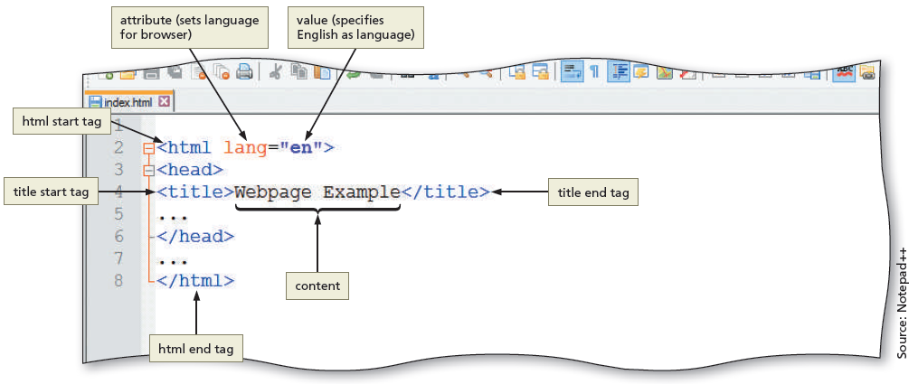
HTML Elements and Attributes (continued 1)
Figure 1–21

Slide 35
HTML Elements and Attributes (continued 2)
HTML combines tags and descriptive attributes that define how a document should appear in a web browser
HTML elements include headings, paragraphs, hyperlinks, lists, and images, have a start tag and an end tag, and follow the same rules, or syntax

Slide 36
HTML Elements and Attributes (continued 3)
HTML elements are called paired tags and use the syntax <start tag> content </end tag>, which has the following meaning:
HTML elements begin with a start tag, or opening tag, such as <title>
HTML elements finish with an end tag, or closing tag, such as </title>
Content is inserted between the start and end tags

Slide 37
HTML Elements and Attributes (continued 4)
Some HTML elements are void of content
They are called empty, or void, tags
Examples of empty tags are <br> for a line break and <hr> for a horizontal line, or rule
The syntax for empty tags is <tag>

Slide 38
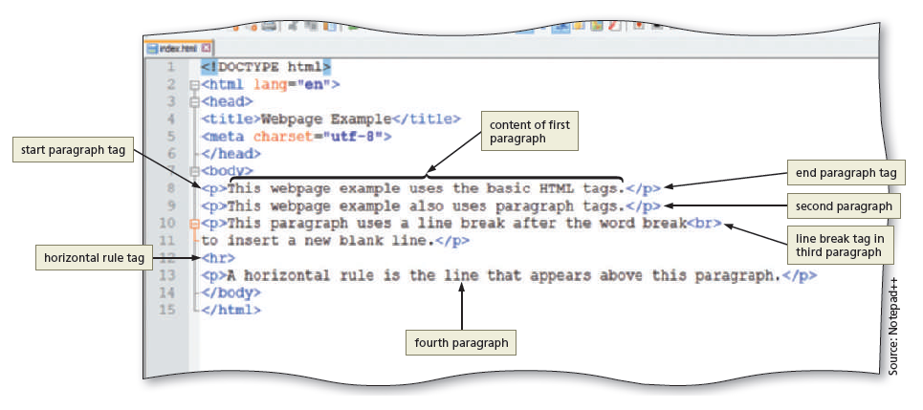
HTML Elements and Attributes (continued 5)
Figure 1–22

Slide 39
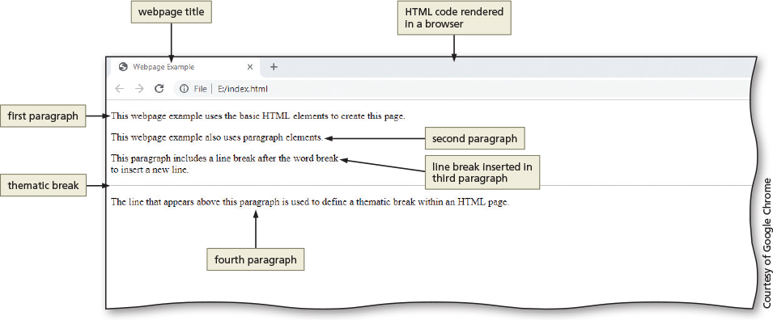
HTML Elements and Attributes (continued 6)
Figure 1–23

Slide 40
Technologies Related to HTML
XML: W3C introduced XML (Extensible Markup Language) in 1998 to exchange and transport data
XHTML (Extensible Hypertext Markup Language): rewritten version of HTML using XML that was developed in 2000 and is accepted on mobile device platforms

Slide 41
HTML 5
The most recent version of HTML
Introduces several new elements such as header, nav, main, and footer to better define the areas of a webpage
Classified as structural elements because they define the structure of a webpage
Also known as semantic HTML elements because they provide meaning about the content of the tags
Provides a more flexible approach to web development

Slide 42
Understanding the Role of Other Web Programming Languages
JavaScript: popular client-side scripting language used to create interactivity within a web browser
The webpages that contain JavaScript are named with an .htm or .html extension
jQuery: library of JavaScript programs designed for easy integration onto a webpage
Makes it easy for web developers to add JavaScript to a webpage

Slide 43
Understanding the Role of Other Web Programming Languages (continued)
PHP (Hypertext Preprocessor): open-source server-side scripting language used for common tasks such as writing to or querying a database located on a central server
Pages that contain PHP scripts must have file names that end with the file extension .php
ASP (Active Server Pages): server-side scripting technology
Pages that contain ASP scripts must have file names that end with the file extension .asp

Slide 44
Using Web Authoring Tools
Webpages can be created using HTML with a simple text editor, such as Notepad++ or Sublime
A text editor program allows one to enter, change, save, and print text, which includes HTML tags
An HTML editor is a program that provides basic text-editing functions, and advanced features such as color-coding for various HTML tags, menus to insert HTML tags, and a spelling checker
HTML is platform independent

Slide 45
Text Editors
Notepad++ is a free, open-source text editor
Used to create files in several markup, scripting, and programming languages, including HTML, CSS, JavaScript, PHP, Java, C#, and Visual Basic
Atom is another free, open-source text editor you can use to create webpages
Available for Windows, macOS, or Linux
Brackets is another cross-platform text editor
TextMate is a free, open-source text editor available for macOS 10.9 or a later version

Slide 46
WYSIWYG and Online Code Editors
WYSIWYG editors
What You See Is What You Get
These editors provide a graphical user interface to design a webpage
They allow users to drag HTML elements onto the page while the editor writes the code
Adobe Dreamweaver is a popular WYSIWYG editor
Online code editors
No software installation required

Slide 47
Creating a Basic Webpage
Every HTML webpage includes basic HTML tags
Refer to the text to review the steps provided
Start Notepad++ and create a blank document
Add basic HTML tags to a document
Add a title and text to a webpage
Save a webpage
View a webpage in a browser
Information on using a different text editor

Slide 48
Chapter Summary
In this chapter, you learned about:
Internet, the web, and associated technologies, including web servers and web browsers
Essential roles of HTML in creating webpages and reviewed tools used to create HTML documents
How to create a basic HTML webpage

